Slide 1
GazePro Measurements
Optimizacija med delovanjem

Slide 2


Avtomatizacija
Korak pred konkurenco
Zmanjšani stroški
Višja kakovost
25%
Prihranek časa

Slide 3



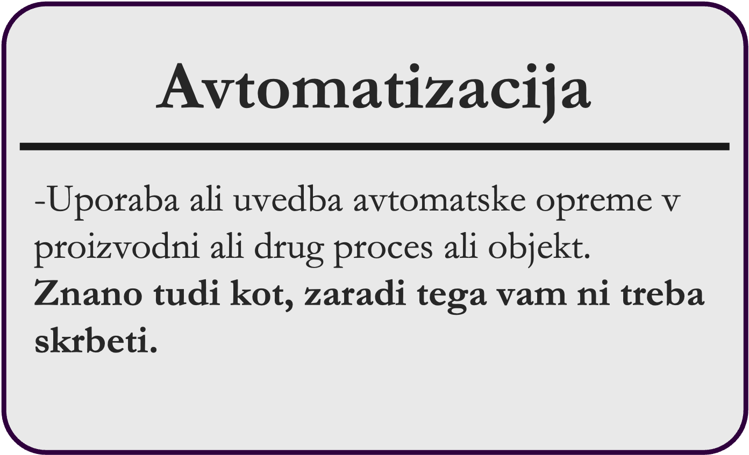
GazePro Measurements

Slide 4
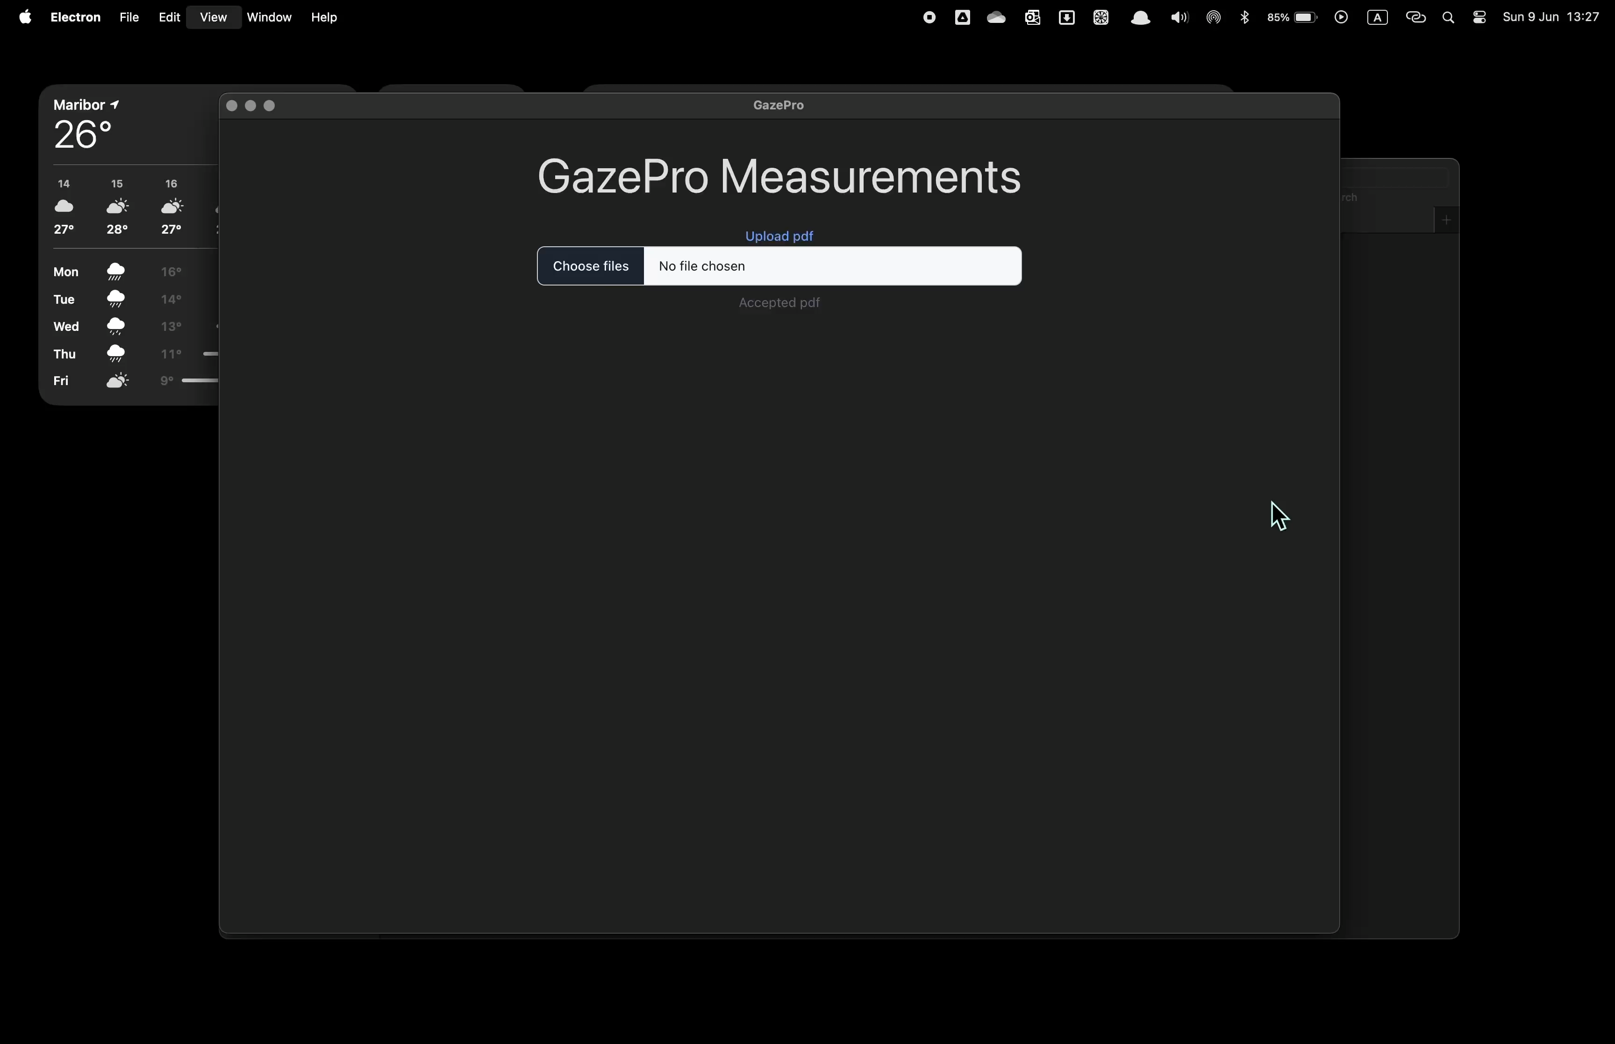
95%
Patient satisfaction

Slide 5
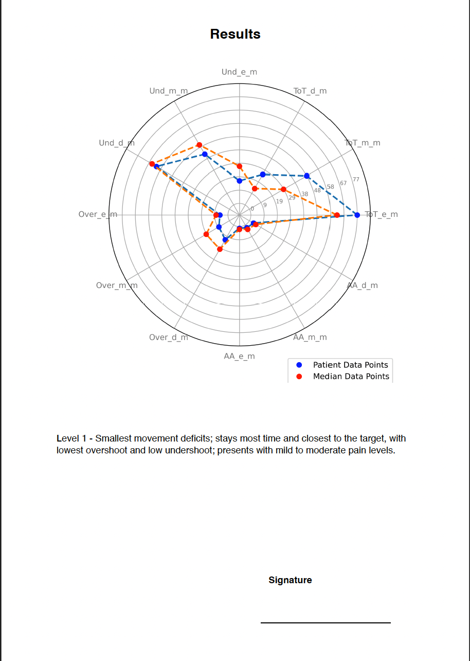
Podatke meritev
Napoved strojnega učenja

Slide 6


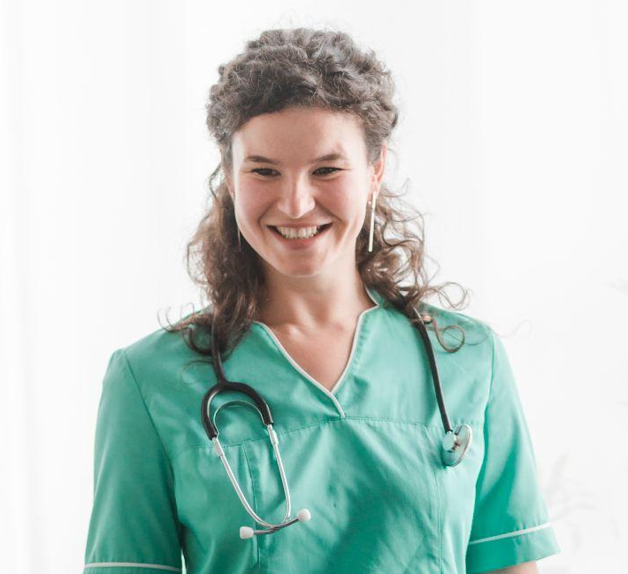
Hvala za vašo pozornost
Timmy Jimmy
Susan Bones
Jenna Doe
You can speak a bit about this person here
You can speak a bit about this person here
You can speak a bit about this person here

Slide 7

Table of contents
01
Our center
02
Key numbers
03
Patient care
04
Key accomplishment
You can describe the topic of the section here
You can describe the topic of the section here
You can describe the topic of the section here
You can describe the topic of the section here

Slide 8

01
Our center
You can enter a subtitle here if you need it

Slide 9
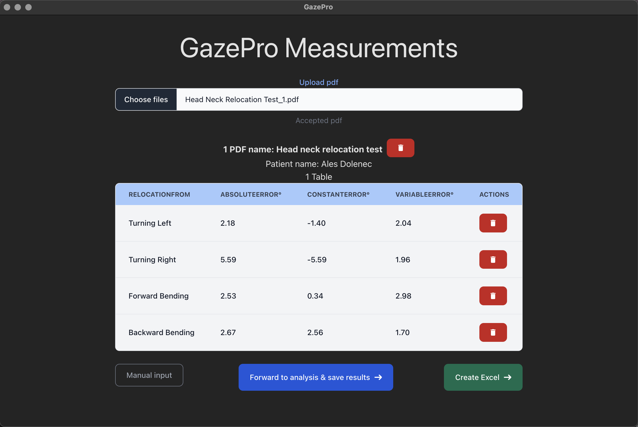
Introduction
Avtomatizacija
-Uporaba ali uvedba avtomatske opreme v proizvodni ali drug proces ali objekt.
Znano tudi kot, zaradi tega vam ni treba skrbeti.

Slide 10

Podatke meritev
Napoved strojnega učenja

Slide 11
Alternative resources

Slide 12
Fonts & colors used
This presentation has been made using the following fonts:
Spectral
(https://fonts.google.com/specimen/Spectral)
Source Sans Pro
(https://fonts.google.com/specimen/Source+Sans)
#191919
#272727
#666666
#F7F7F7
#95D2D5
#5E9393

